Slide 1
Classification Of Cyber Crimes

Slide 2
Stages
(1) Cyber crime against Individual
(2) Cyber crime Against Property
(3) Cyber crime Against Organization
(4) Cyber crime Against Society

Slide 3
Against Individual
(i) Email spoofing : A spoofed email is one in which e-mail header is forged so that mail appears to originate from one source but actually has been sent from another source
(ii) Spamming : Spamming means sending multiple copies of unsolicited mails or mass e-mails such as chain letters.
(iii) Cyber Defamation : This occurs when defamation takes place with the help of computers and / or the Internet. E.g. someone publishes defamatory matter about someone on a website or sends e-mails containing defamatory information.
(iv) Harassment & Cyber stalking : Cyber Stalking Means following the moves of an individual's activity over internet. It can be done with the help of many protocols available such at e- mail, chat rooms, user net groups.

Slide 4
Against Property
i) Credit Card Fraud :
(ii) Intellectual Property crimes : These include Software piracy: illegal copying of programs, distribution of copies of software. Copyright infringement: Trademarks violations: Theft of computer source code:
(iii) Internet time theft : the usage of the Internet hours by an unauthorized person which is actually paid by another person.

Slide 5
Against Organization
(i) Unauthorized Accessing of Computer: Accessing the computer/network without permission from the owner. it can be of 2 forms:
a) Changing/deleting data: Unauthorized changing of data.
b) Computer voyeur: The criminal reads or copies confidential or proprietary information, but the data is neither deleted nor changed.
(ii) Denial Of Service : When Internet server is flooded with continuous bogus requests so as to denying legitimate users to use the server or to crash the server.
(iii) Computer contamination / Virus attack : A computer virus is a computer program that can infect other computer programs by modifying them in such a way as to include a (possibly evolved) copy of it. Viruses can be file infecting or affecting boot sector of the computer. Worms, unlike viruses do not need the host to attach themselves to.

Slide 6
Cont….
(iv) Email Bombing : Sending large numbers of mails to the individual or company or mail servers thereby ultimately resulting into crashing.
(v) Salami Attack : When negligible amounts are removed & accumulated in to something larger. These attacks are used for the commission of financial crimes.
(vi) Logic Bomb : Its an event dependent programme , as soon as the designated event occurs, it crashes the computer, release a virus or any other harmful possibilities.
(vii) Trojan Horse : an unauthorized program which functions from inside what seems to be an authorized program, thereby concealing what it is actually doing.
(viii) Data diddling : This kind of an attack involves altering raw data just before it is processed by a computer and then changing it back after the processing is completed.

Slide 7
Against Society
(i) Forgery : currency notes, revenue stamps, mark sheets etc can be forged using computers and high quality scanners and printers.
(ii) Cyber Terrorism : Use of computer resources to intimidate or coerce others.
(iii) Web Jacking :Hackers gain access and control over the website of another, even they change the content of website for fulfilling political objective or for money.

Slide 8
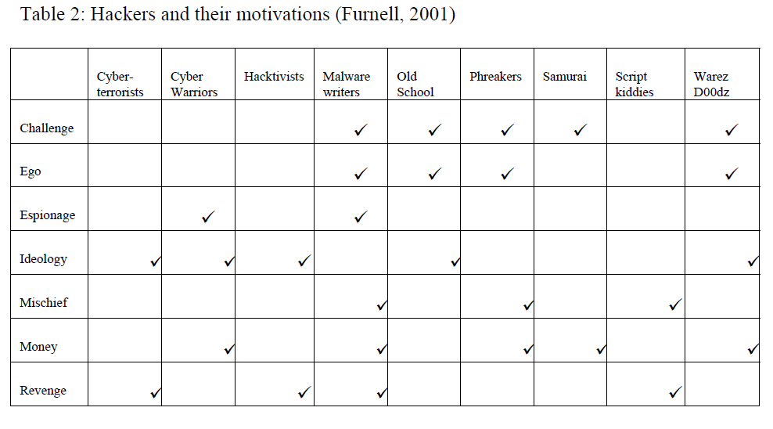

Slide 9
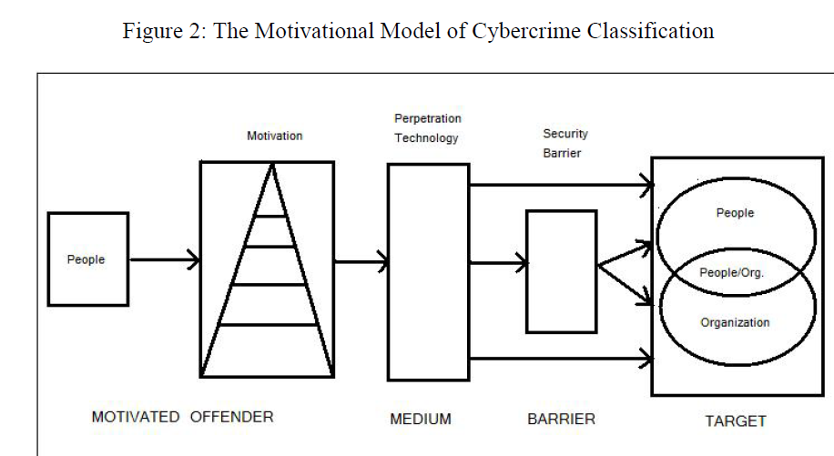

Slide 10
